Slide 1


EYEBALL CONTROLLED AUTOMATIC WHEELCHAIR..
Roll no | Name
EC22B005 | Elatchiya Chagla
EC22B007 | Harshitha .R
Notes:
Notes for Teachers:
The Synopsis presentation should contain 1. Real life applications 2. Overview of the subject 3. PO’s CO’s of the course 4. Individual Units overview 5. Lesson Plan 6. Flip Class topics
“ Be professionally dressed and use a QUALITY PEN. Never hand an ordinary PEN as a Cosmetic Effect”

Slide 2

ABSTRACT
This is an optical type eye tracking system which uses eyeball movement of human to control the wheelchair.
It is helpful for handicapped people in order to move their wheelchair in a proper direction without any assistance from other.

Slide 3

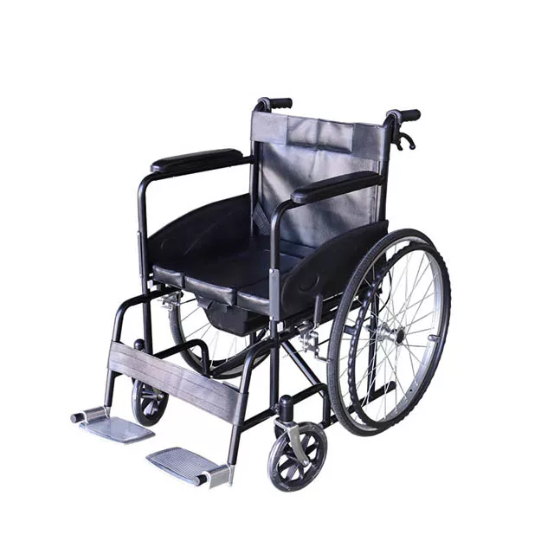
EXISTING SYSTEM

Slide 4

In the existing system,they are giving remote control type of wheelchair controlling system is present in a wheelchair.
But this system is not much helpful for paralyzed and handicapped peoples.
So, we go for brain-computer interface based on the eyeball movement.

Slide 5

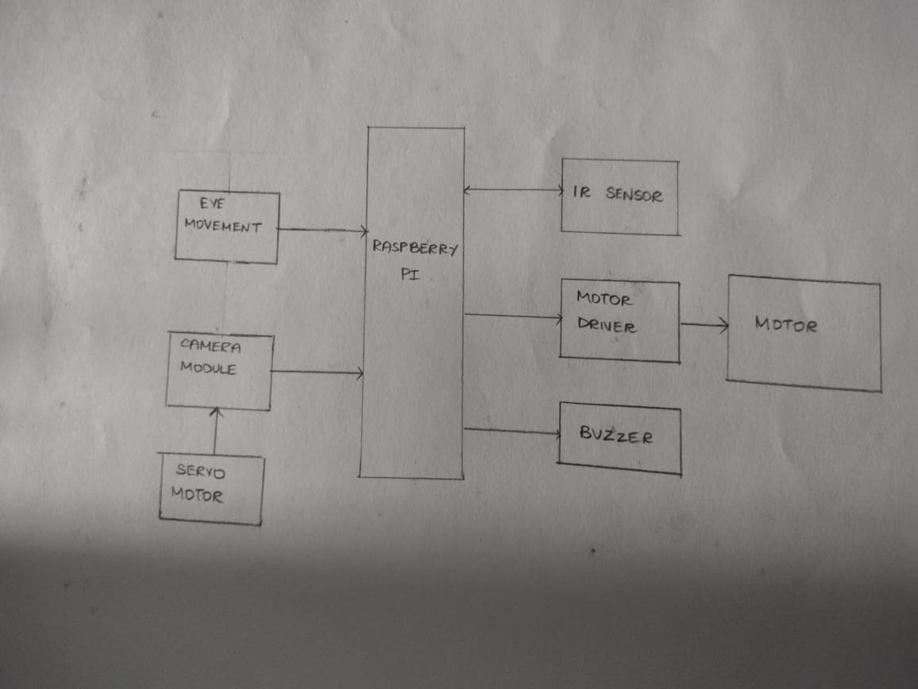
PROPOSED SYSTEM

Slide 6

In this method the camera is focused on the eye by using RASPBERRY PI.
By tracking the eyeball movement,we can move the wheelchair accordingly.

Slide 7

ADVANTAGES...
Using eye ball sensor we can easily calculate the threshold values of position.
Using eye ball sensors instead of the CCD camera will also reduce the cost of the total system.

Slide 8
SOURCE CODE
https://onlinegdb.com/i83XH-5UH

Slide 9

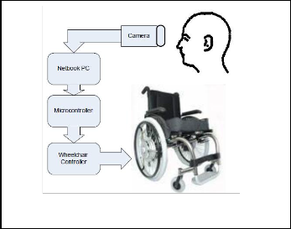
Block Diagram

Slide 10


